Slide 1
Question 1

Slide 2

COUNTING THE MALE AND FEMALE COUNT USING COUNTIF

Slide 3
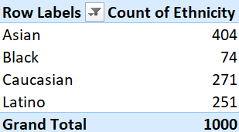
USING PIVOT TABLE TO FIND THE COUNT OF ETHNICITY

Slide 4
Question 2

Slide 5
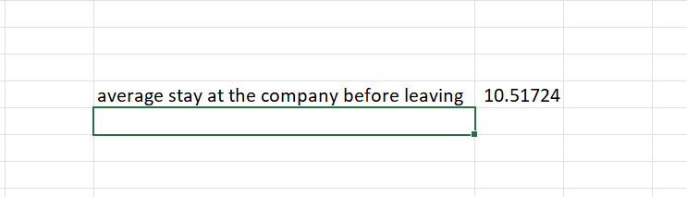
TAKE THE LIST OF PEOPLE WHO LEFT THE COMPANY AND CALCULATE THE NUMBER OF YEARS THEY STAYED AND FIND THE AVERAGE

Slide 6
Question 3

Slide 7
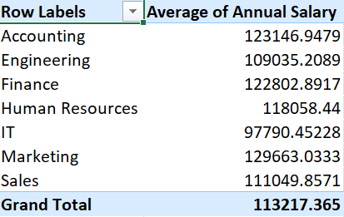

Slide 8
Question 4

Slide 9
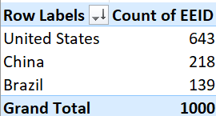
FROM TAKING THE NUMBER OF EMPLOYEES IN EACH COUNTRY
AND SORTING IT FROM LARGEST WE GET THE HIGHEST NO OF EMPLOYES IN UNITED STATES

Slide 10
Question 5

Slide 11
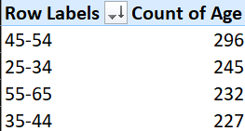
BY GROUPING THE AGE IN RANGE OF 10 AND COUNTING THE NUMBERS AND FINDING THE HIGHEST COUNT GIVESTHE MOST COMMON AGE RANGE IS 45-54
ANS:

Slide 12
Question 6

Slide 13
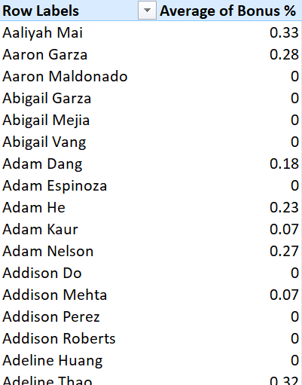
INDIVIDUAL AVERAGE OF BONUS

Slide 14

GRAND TOTAL OF AVERAGE OF BONUS%

Slide 15
Question 7

Slide 16
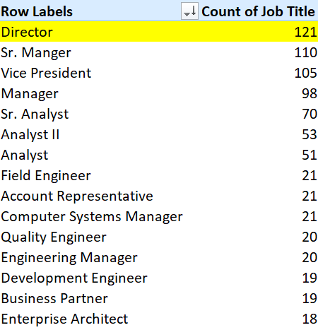
COUNTING THE OCCURRENCE OF JOB TITLE AND FINDING THE HIGHEST TO FIND THE MOST FREQUENT ONE

Slide 17
Question 8

Slide 18
https://github.com/lanc-latentv/Assess/tree/66d3426f184f2eb8cb712253bf5155f4aa8bd670/Excel/internal%20assessment%201

Slide 19
Question 9

Slide 20
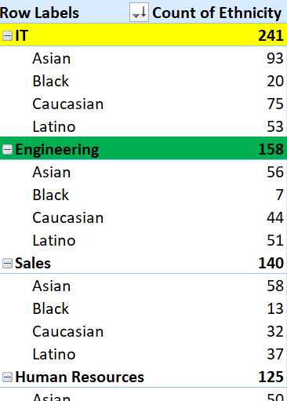
WE CAN SEE THAT EACH DEPARTMENT HAVE DIFFERENT ETHNICITY AND THE COUNT OF IT, FROM THE SUBTOTAL VALUE WE CAN FIND THAT IT HAVE THE HIGHEST COUNT OF ETHNICITY, DIVERSE PEOPLE

